Slide 1
The Bag of Holding
Karolina Dudek

Slide 2
The Brief
The brief
Solution
Testing
Front End
CI Pipeline
Demonstration
Summary
Technology restrictions:
Kanban Board: Trello or an equivalent Kanban Board
Database: h2
Programming language: Java (unless stated otherwise)
Front-end: HTML, CSS and JavaScript, possibly using a front-end library such as React
Unit Tests: JUnit and Mockito
Integration Tests: Selenium
Version Control: Git
CI Server: Jenkins
Cloud server: AWS, GCP or Azure virtual machine
Individual work
CI pipeline
80% test coverage
OOP based application
CRUD functionality

Slide 3
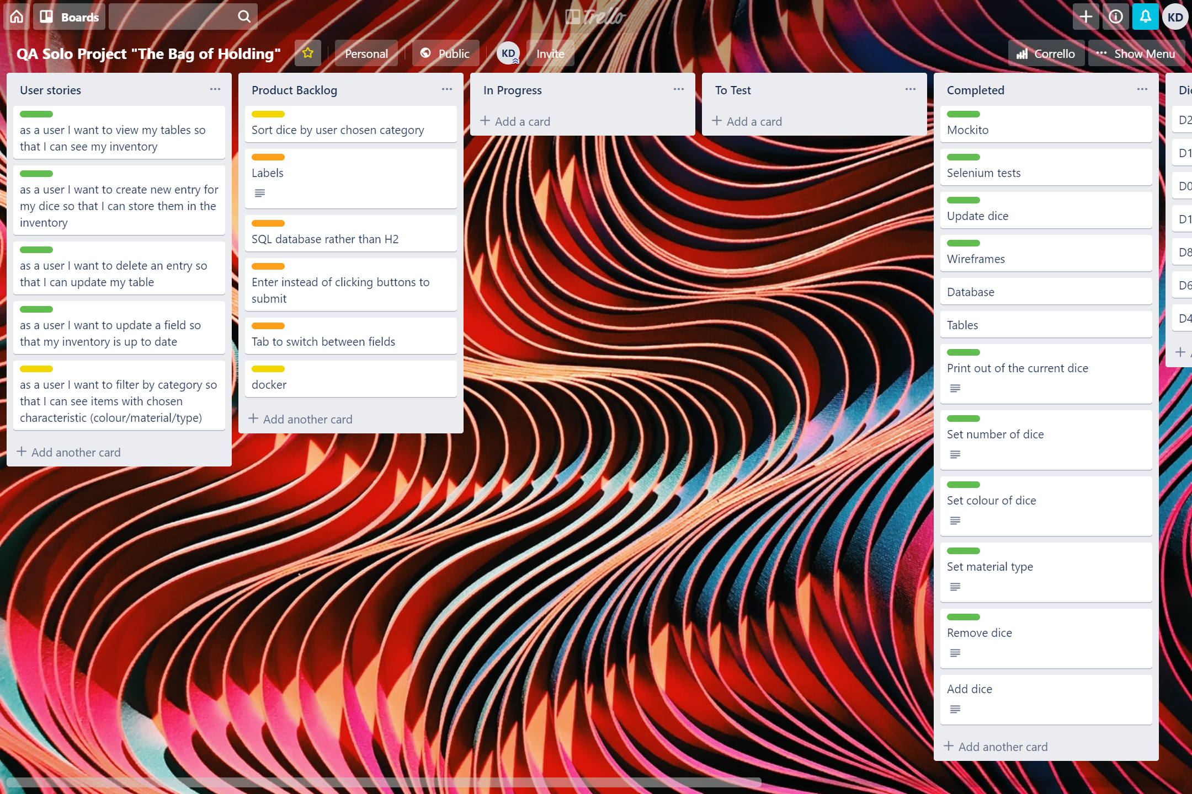
Project tracking - Trello
The brief
Solution
Testing
Front End
CI Pipeline
Demonstration
Summary

Slide 4
Entity Relationship Diagrams
The brief
Solution
Testing
Front End
CI Pipeline
Demonstration
Summary

Slide 5
Testing – JUnit & Mockito
The brief
Solution
Testing
Front End
CI Pipeline
Demonstration
Summary

Slide 6
Testing - Selenium
The brief
Solution
Testing
Front End
CI Pipeline
Demonstration
Summary

Slide 7
Dashboard – Initial Wireframe
The brief
Solution
Testing
Front End
CI Pipeline
Demonstration
Summary

Slide 8
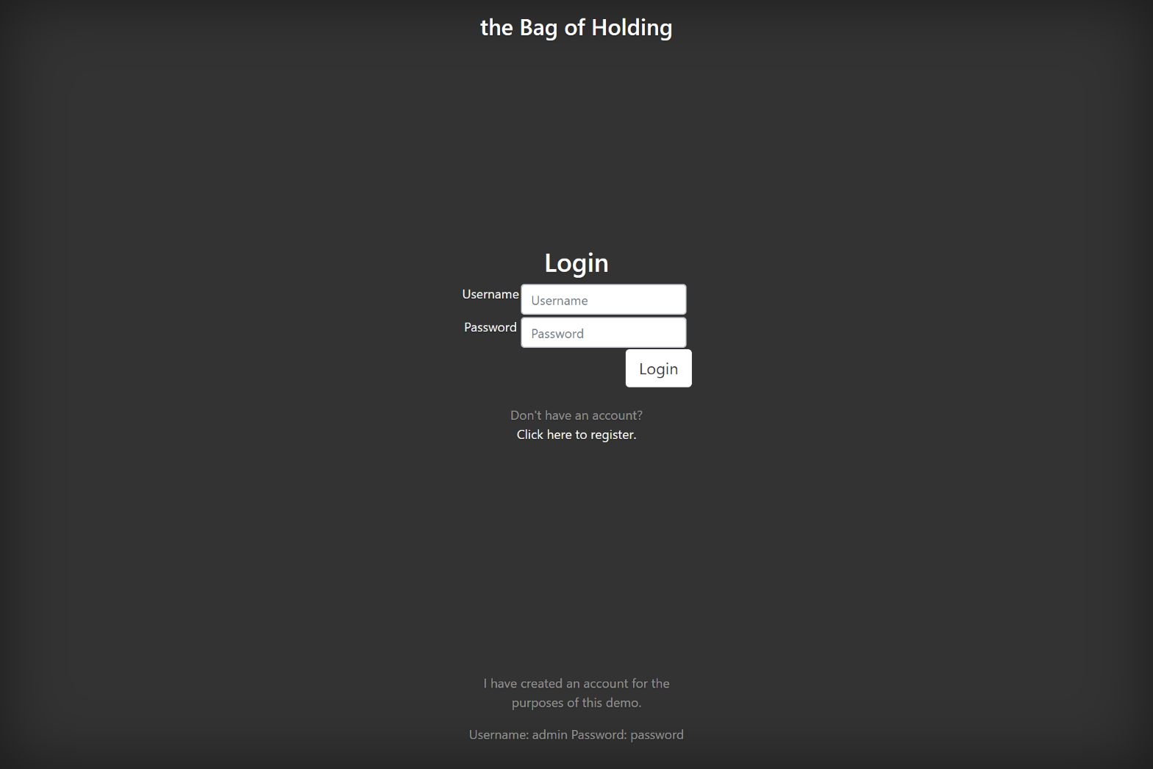
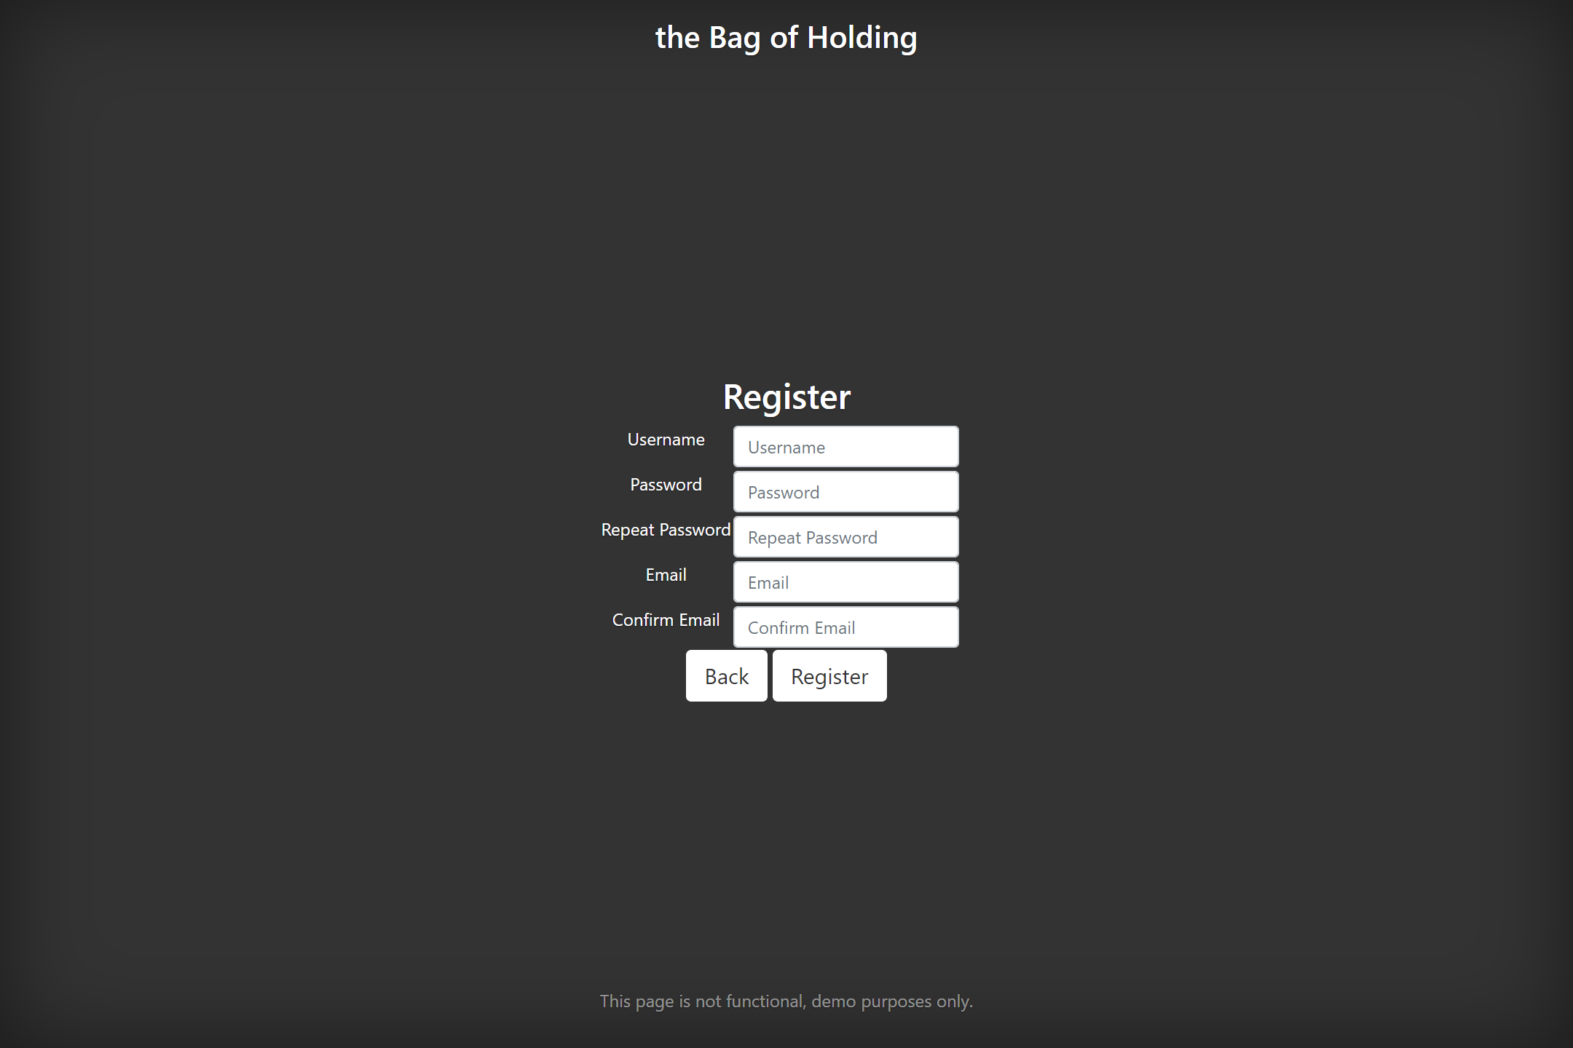
Index – Login & Registration
The brief
Solution
Testing
Front End
CI Pipeline
Demonstration
Summary

Slide 9
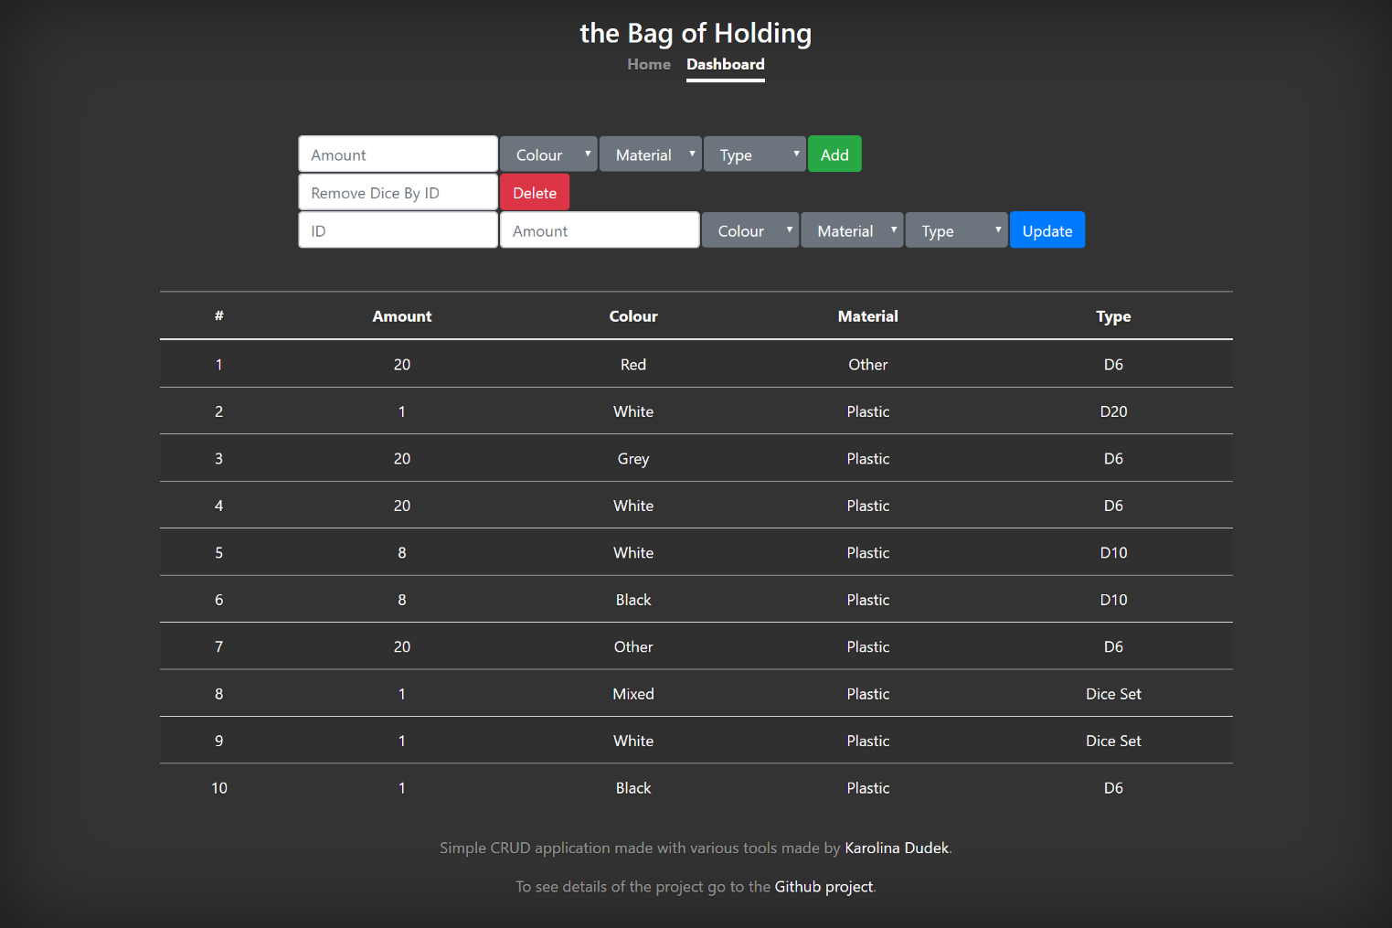
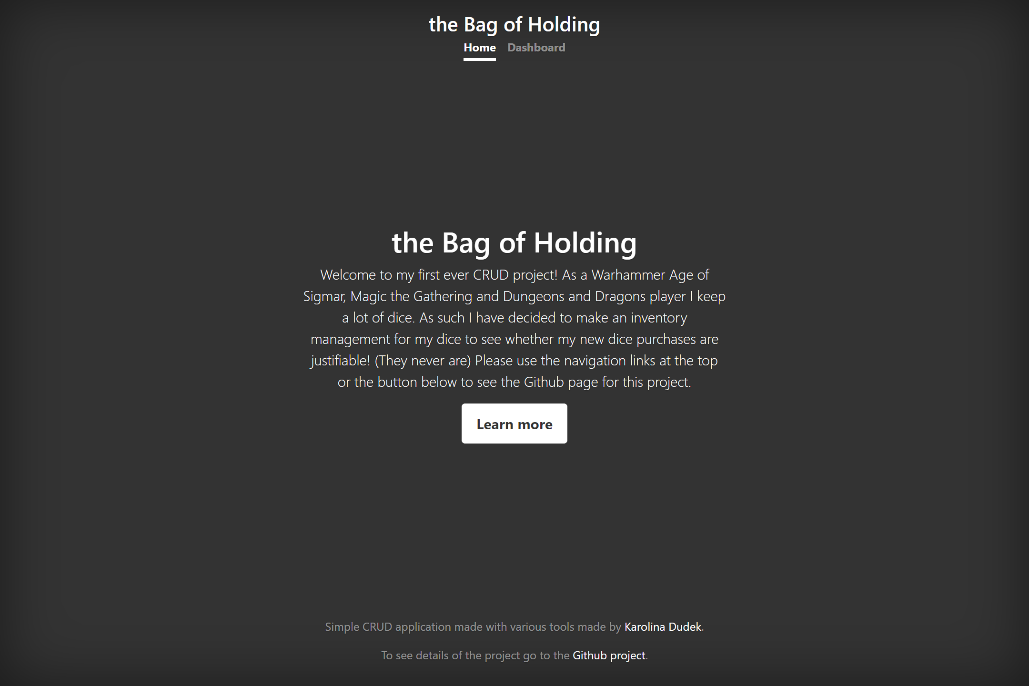
Index – Home & Dashboard
The brief
Solution
Testing
Front End
CI Pipeline
Demonstration
Summary

Slide 10
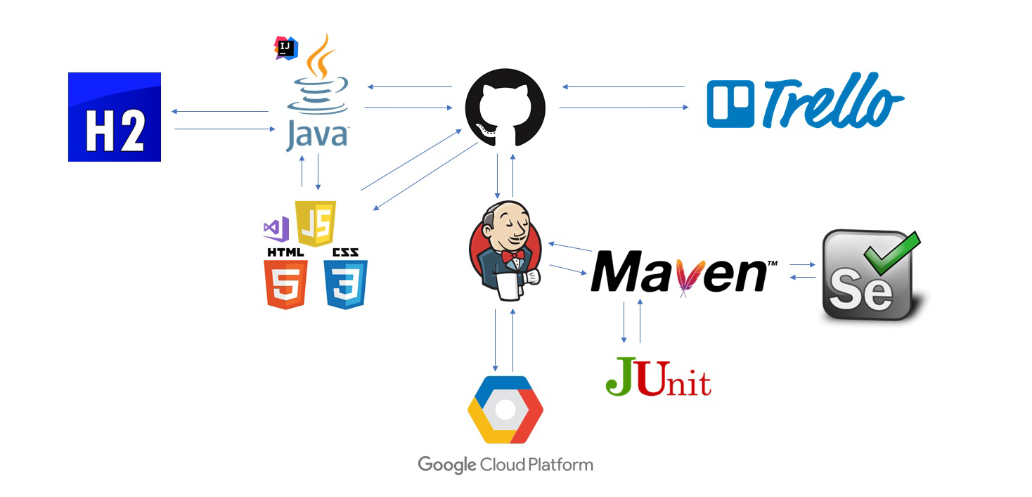
Technologies Used – CI Pipeline
The brief
Solution
Testing
Front End
CI Pipeline
Demonstration
Summary

Slide 11
Summary
The brief
Solution
Testing
Front End
CI Pipeline
Demonstration
Summary
Accomplishments
List of good
Improvements
List of bad

Slide 12
Demonstration
The brief
Solution
Testing
Front End
CI Pipeline
Demonstration
Summary

Slide 13
Questions and Feedback
Thank you for listening

